Slide 1
HCI
Lecture 1

Slide 2




the human

Slide 3
the human
Information Processing Model
The perceptual system
The motor system
The cognitive system

Slide 4
Human Modeling
Model Human Processor: Card, Moran and Newell. 1983
The model comprises three subsystems; the perceptual system, handling sensory stimulus from the outside world, the motor system, which controls actions, and the cognitive system, which provides the processing needed to connect the two.

Slide 5
The human
Information i/o …
visual, auditory, haptic, movement
Information stored in memory
sensory, short-term, long-term
Information processed and applied
reasoning, problem solving, skill, error
Emotion influences human capabilities
Each person is different

Slide 6
The Perceptual
System
(Input)

Slide 7
Information i/o
Vision
Size and depth
Brightness
Colour
Reading
Hearing
Touch
May be key sense for someone who is visually impaired.
Stimulus received via receptors in the skin
Movement
Movement time dependent on age, fitness etc.
Notes:
Size and depth
visual angle indicates how much of view object occupies (relates to size and distance from eye)
visual acuity is ability to perceive detail (limited)
Brightness
subjective reaction to levels of light
affected by luminance of object
visual acuity increases with luminance as does flicker
Colour
made up of hue, intensity, saturation
cones sensitive to colour wavelengths
blue acuity is lowest
8% males and 1% females colour blind
Several stages:
visual pattern perceived
decoded using internal representation of language
interpreted using knowledge of syntax, semantics, pragmatics
Reading involves saccades and fixations
Perception occurs during fixations
Word shape is important to recognition
Provides information about environment: distances, directions, objects etc.
Physical apparatus: (Ear)
Sound
pitch – sound frequency
loudness – amplitude
timbre – type or quality
Humans can hear frequencies from 20Hz to 15kHz
Auditory system filters sounds
can attend to sounds over background noise.
for example, the cocktail party phenomenon.

Slide 8
Vision
120 million are rods vs 5 million are cones
Peripheral Vision
Peripheral vision: Side vision. The ability to see objects and
movement outside of the direct line of vision.
Peripheral vision is the work of the rods, nerve cells located
largely outside the macula (the center) of the retina.
The rods are also responsible for night vision and low-light vision but are
insensitive to color.

Slide 9
Vision
Design Choices: Peripherals
So if you want a user to see an error message at the bottom of the screen it had better be flashing.
Moving fancy impressive icons will be distracting even when the user is not looking directly at them
In TV or Computer screens, the larger the display (and consequently the more peripheral vision that it occupies), the more it will appear to flicker.
A negative contrast (dark characters on a light screen) provides higher luminance and, therefore, increased acuity. On the other hand, if the luminance increases, the flicker also increases!

Slide 10
Hearing
Design Choices: Sounds
Attention -to attract the user's attention to a critical situation or to the end of a process
Status information - continuous background sounds can be used to convey status information. For example, monitoring the progress of a process
Confirmation - a sound associated with an action to confirm that the action has been carried out. For example, associating a sound with deleting a file.
Navigation -using changing sound to indicate where the user is in a system. For example, what about sound to support navigation in hypertext?

Slide 11
The Motor
System
(Output)
Reaction
A person can react to an
A visual signal in 200 ms,
Auditory signal in 150 ms, and
Pain in 700 ms
Combination of signals produce faster response
Practice improves reaction time

Slide 12
The Cognitive
System
Brain = Processor
Memory = RAM/HDD

Slide 13
Sensory Memories
Buffers for stimuli received through senses, Continuously overwritten (Buffer)
Information Decay (~ 0.5 seconds)
Sparkler Trail. Stereo Sound (Playback). Hot Surfaces
Iconic memory. Echoic memory. Haptic memory
(Visual stimul) (aural stimuli) (tactile stimuli)
(aural stimul)
Iconic memory
(Visual stimul)
Sparkler Trail
Iconic memory
(Visual stimul)
Stereo Sound (Playback)
Echoic memory
(aural stimuli)
Hot Surfaces
ng
Haptic memory
(tactile stimuli)
ng

Slide 14
Short-Term Memory (or working memory)
Chunks Span (7 +/- 2)
that is near the Digit Span!!! 123. 456. 789 012. 345
Our subconscious desire to create chunks to optimize memory capacity
The successful formation of a chunk is known as “Closure"
Recency Effect -Short term memory tends to remember the last events
Interference Effect -Inputs at the same channel affects capacity

Slide 15
Short-Term Memory (or working memory)
Scratch Pad for temporary recall
Limited Capacity (7 +/- 2)
Rapid access ~ 70ms
Rapid decay 200ms
Increased with Familiarity Effect
Increased with Recency Effect
Affected by interference at the same channel
Menus shouldn't have more than 7 +/- 2 items
Function calls while coding shouldn't have more than 7 parameters (CheckStyle guide)
The "Closure" of some use-case (e.g., ATM) must be designed carefully

Slide 16
Long Term Memory
There are two types:
Episodic: represents our memory of events and experiences in a serial form
Semantic: skills, concepts and facts extracted from the Episodic.
Properties
Huge (or infinite)
Slow access time 0.1 second
Slow (or no) decay

Slide 17
Memory
There are three types of memory function:
Sensory memories
Short-term memory or working memory
Long-term memory
Selection of stimuli governed by level of arousal.
Attention
Rehearsal

Slide 18
Thinking
Reasoning
deduction, induction, abduction
Problem solving

Slide 19
Thinking: Reasoning
Deduction:
derive logically necessary conclusion from given premises.
e.g. If it is Sunday then she will go to work
It is Sunday
Therefore she will go to work.
Logical conclusion not necessarily true:
e.g. If it is raining then the ground is dry
It is raining
Therefore the ground is dry
Induction:
generalize from cases seen to cases unseen
e.g. all elephants we have seen have trunks therefore all elephants have trunks.
Unreliable:
can only prove false not true
… but useful!
Humans not good at using negative evidence

Slide 20
Problem solving
Process of finding solution to unfamiliar task using knowledge.
Problem space theory
problem space comprises problem states
problem solving involves generating states using legal operators
heuristics may be employed to select operators
operates within human information processing system
largely applied to problem solving in well-defined areas e.g. puzzles rather than knowledge intensive areas

Slide 21
Emotion
Emotion clearly involves both cognitive and physical responses to stimuli
The biological response to physical stimuli is called affect
Affect influences how we respond to situations
positive → creative problem solving
negative → narrow thinking
“Negative affect can make it harder to do even easy tasks; positive affect can make it easier to do difficult tasks” (Donald Norman)
Implications for interface design
stress will increase the difficulty of problem solving
relaxed users will be more forgiving of shortcomings in design
visually pleasing and rewarding interfaces will increase positive affect

Slide 22
Individual differences
long term – sex, physical and intellectual abilities
short term – effect of stress or fatigue
changing – age
Ask yourself: will design decision exclude section of user population?

Slide 23
Psychology and the Design of Interactive System
Some direct applications
e.g. blue acuity is poor ⇒ blue should not be used for important detail
However, correct application generally requires understanding of context in psychology, and an understanding of particular experimental conditions
A lot of knowledge has been distilled in
guidelines (chap 7)
cognitive models (chap 12)
experimental and analytic evaluation techniques (chap 9)

Slide 24




the computer

Slide 25
The Computer
a computer system is made up of various elements
each of these elements affects the interaction
input devices – text entry and pointing
output devices – screen (small&large), digital paper
virtual reality – special interaction and display devices
physical interaction – e.g. sound, haptic, bio-sensing
paper – as output (print) and input (scan)
memory – RAM & permanent media, capacity & access
processing – speed of processing, networks

Slide 26

Interacting with computers
to understand human–computer interaction … need to understand computers!
what goes in and out devices, paper, sensors, etc.
what can it do? memory, processing, networks

Slide 27
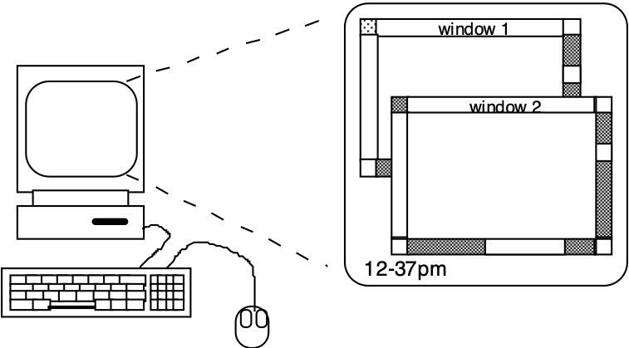
A ‘typical’ computer system
screen, or monitor, on which there are windows
keyboard
mouse/trackpad
variations
desktop
laptop
PDA
the devices dictate the styles of interaction that the system supports
If we use different devices, then the interface will support a different style of interaction
?

Slide 28

How many computers …
in your house?
PC
TV, VCR, DVD, HiFi, cable/satellite TV
microwave, cooker, washing machine
central heating
security system
can you think of more?
in your pockets?
PDA
phone, camera
smart card, card with magnetic strip?
electronic car key
USB memory
try your pockets and bags

Slide 29
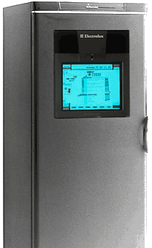
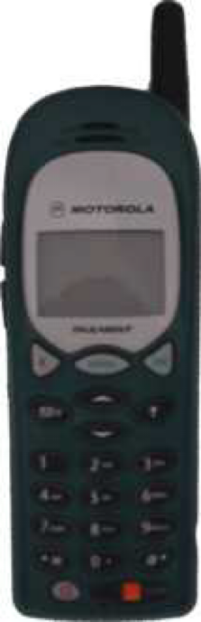
Richer interaction
sensors
and devices
everywhere

Slide 30
text entry devices
Keyboards : Most common text input device
Handwriting recognition :Text can be input into the computer, using a pen and a digesting tablet
Speech recognition- Improving rapidly
Most successful when:
single user – initial training and learns peculiarities
limited vocabulary systems
Numeric keypads
for entering numbers quickly:
calculator, PC keyboard
for telephones ,ATM like phone
1
2
3
7
8
9
4
5
6
4
5
6
7
8
9
1
2
3
*
.
0
#
0
=
telephone
calculator
Notes:
Keyboards
Most common text input device
Allows rapid entry of text by experienced users
Keypress closes connection, causing a character code to be sent
Usually connected by cable, but can be wireless
Handwriting recognition
Text can be input into the computer, using a pen and a digesting tablet
natural interaction
Technical problems:
capturing all useful information - stroke path, pressure, etc. in a natural manner
segmenting joined up writing into individual letters
interpreting individual letters
coping with different styles of handwriting
Speech recognition- Improving rapidly
Most successful when:
single user – initial training and learns peculiarities
limited vocabulary systems
Problems with
external noise interfering
imprecision of pronunciation
large vocabularies
different speakers
Numeric keypads
for entering numbers quickly:
calculator, PC keyboard
for telephones
not the same!!

Slide 31
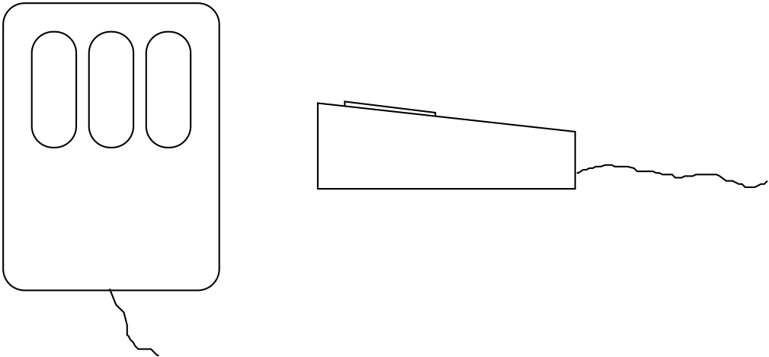
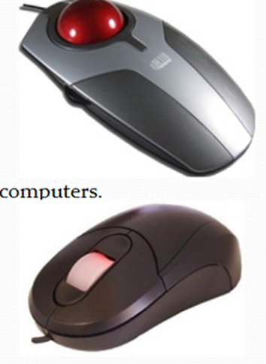
the Mouse
Handheld pointing device (very common, easy to use, requires physical space)
Two characteristics
planar movement
Buttons (usually from 1 to 3 buttons )
Two methods for detecting motion
Mechanical using Ball (Rotates orthogonal potentiometers)
Optical (light )
Even by foot …
some experiments with the footmouse
controlling mouse movement with feet …,not very common
Touchpad &Trackball
Joystick and keyboard nipple
Touch-sensitive screen
Stylus and light pen
Digitizing tablet
Eyegaze & Cursor keys

Slide 32
display devices
Resolution and colour depth
Resolution … used (inconsistently) for
Aspect ratio
Colour depth
Health hazards of CRT !
large displays
situated displays

Slide 33
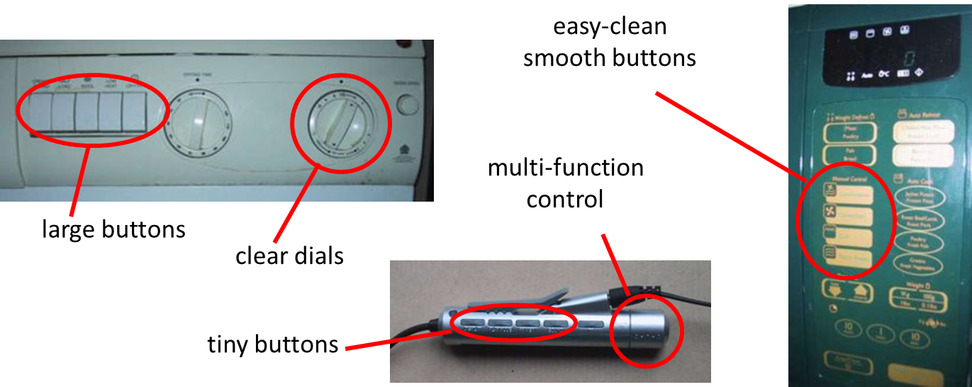
physical controls, sensors etc.
Sounds
used for error indications
confirmation of actions e.g. keyclick
touch and feeling important
in games … vibration, force feedback
in simulation … feel of surgical instruments
texture, smell, taste
current technology very limited
physical controls

Slide 34
Memory
short term and long term
Short term: Random access memory (RAM)
Long term: magnetic disks, CD-ROM, DVD
speed, capacity, compression
formats, access

Slide 35
processing and networks Finite processing speed
Designers tend to assume fast processors, and make interfaces more and more complicated
But problems occur, because processing cannot keep up with all the tasks it needs to do
cursor overshooting because system has buffered keypresses
icon wars - user clicks on icon, nothing happens, clicks on another, then system responds and windows fly everywhere
Also problems if system is too fast - e.g. help screens may scroll through text much too rapidly to be read

Slide 36
Limitations on interactive performance
Computation bound
Computation takes ages, causing frustration for the user
Storage channel bound
Bottleneck in transference of data from disk to memory
Graphics bound
Common bottleneck: updating displays requires a lot of effort - sometimes helped by adding a graphics co-processor optimise to take on the burden
Network capacity
Many computers networked - shared resources and files, access to printers etc. - but interactive performance can be reduced by slow network speed

